Slide 1
The Energy Union, the Integrated SET Plan and Horizon 2020
Philippe SCHILD
Senior expert
European Commission, DG Research and Innovation Unit G.3, Renewable Energy Sources

Slide 2
Structure
Horizon 2020 : Keys figures
EU Policy & Research Approach
Towards an European Energy Union
Towards an integrated Strategy Energy Technology Plan (SET-Plan)
On the horizon
Mid-term review of H2020
Last work-programme of H2020

Slide 3
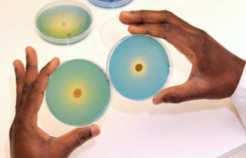
What is Horizon 2020?
Horizon 2020
Overall aims
€70 billion Research & Innovation programme (2014-2020)
Key objectives:
Respond to the crisis: invest in future growth and jobs
Address people’s concerns: livelihoods, safety and environment
Strengthen the EU’s global position: in research, innovation and technology
Excellent science
Industrial leadership
Societal challenges
Notes:
H2020 is a core part of Europe 2020, Innovation Union & European Research Area

Slide 4
EU Budget 2014-2020 to achieve Europe 2020 Agenda: European Council conclusions, 8 February 2013
Horizon 2020
R&I Programmes
EU Budget & Research
Key challenge: stabilise the financial and economic system while taking measures to create economic opportunities and create growth and jobs
Smart & inclusive growth (€451 billion)
Sustainable growth, natural resources (€373 billion)
Security and citizenship (€16 billion)
Global Europe (€58 billion)
Administration (€61.6 billion)
HORIZON 2020
Aprox 70 bn
Education, Youth, Sport
Connecting Europe
Competitive Business SMEs
Cohesion
TOTAL
€960 billion

Slide 5
Policy priorities in work programs 2014-2020
Horizon 2020
Work Programs
Program 2014-2015: Boost competitiveness & innovation, job creations, address societal challenges
Program 2016-2017: same but with 10 priorities
Industry 2020 in Circular Economy
Sustainable Food Security
Energy Efficiency
Digital Security
Blue growth – ocean of opportunities
Internet of Things
Competitive Low-Carbon Energy
Smart & Sustainable Cities
Automated Road Transport
Cross-cutting with Social Sciences and Humanities
Program 2018-2020: (O-O-O)
Open Innovation, Open Science, Open to the World.
Engage with partners on global challenges: energy, health food, water, value chains and emerging markets

Slide 6
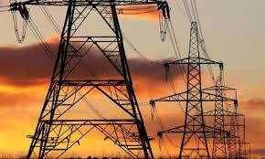
Energy challenge (approx. €6 billion)
Horizon 2020
Energy Challenge
Support the transition to a reliable, sustainable and competitive energy system by:
Reducing energy consumption and carbon footprint
Making the power grid more flexible
Growth & integration of renewable & alternative energy technologies
Competitiveness of EU industry:
Whole supply chain
Energy efficiency
Cost effective energy systems
Decarbonising the power & other industrial sectors

Slide 7
Key Figures (2014-2015)
Horizon 2020
Challenge Energy
So far
H2020 calls:
EUR 1,212 billion in 443 projects - <2,7M€>/project
Energy Efficiency
Low Carbon Energy (RES, CCS, Smart Grids & Storage)
Smart Cities & Communities
SME Instrument
JU FCH: 130M€
3925 proposals received (EUR 8,45 billions)
- SME Instruments: 58% (11%)
- Energy Efficiency: 24% (24%)
- Low Carbon Energy: 16% (49%)
- Smart Cities & Communities: 2% (16%)
Notes:
Making the grid more flexible (inclusion of new energy sources, lowering costs of necessary infrastructure upgrades)
the Fuel Cell and Hydrogen 2 Joint Undertaking (FCH 2 JU), outlining the scope and details of its operational and horizontal activities for the year 2016.
FCH 2 JU is a public-private partnership focusing on the objective of accelerating the commercialization of fuel cell and hydrogen technologies

Slide 8
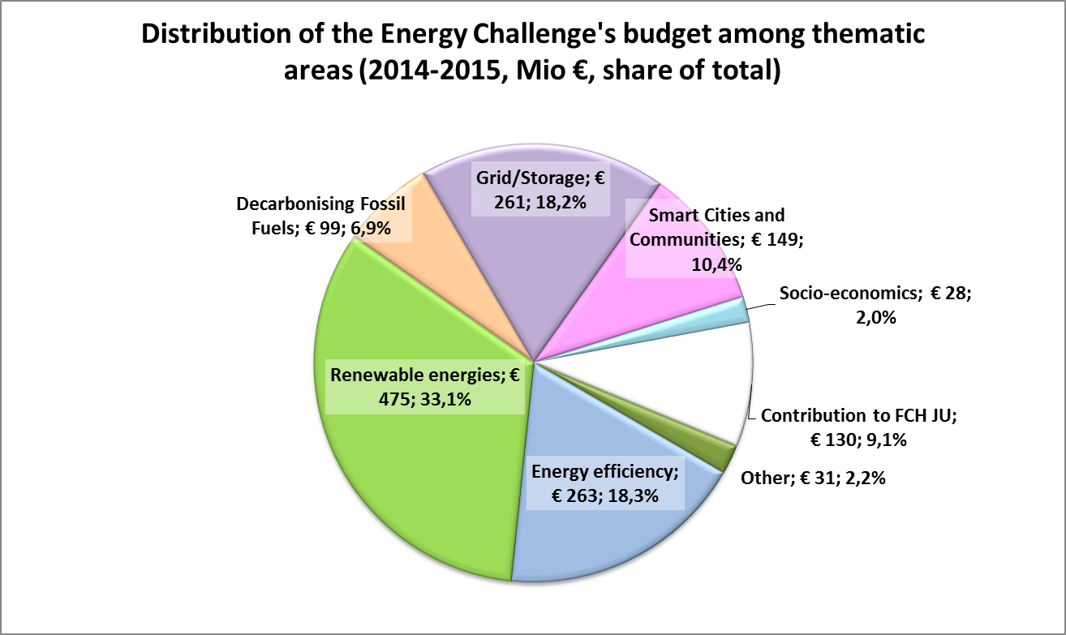
Horizon 2020
Challenge Energy
So far

Slide 9
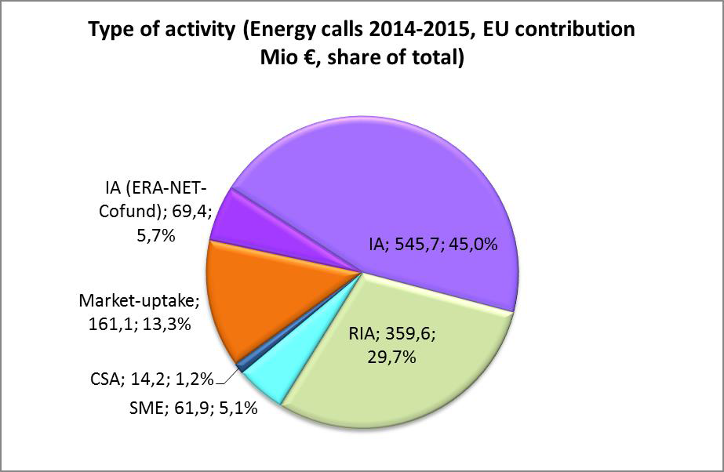
Horizon 2020
Challenge Energy
So far

Slide 10
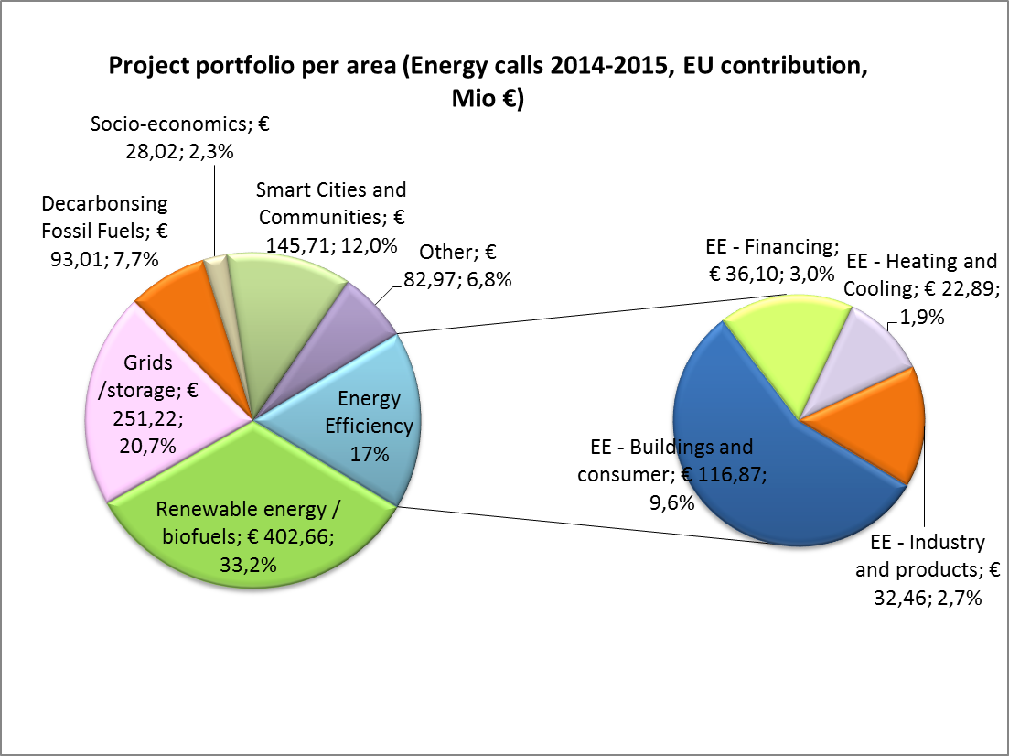
Horizon 2020
Challenge Energy
So far

Slide 11
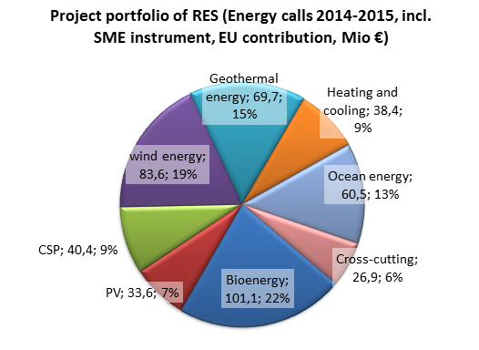
Horizon 2020
Challenge Energy
So far
Notes:
CSP: Concentrated solar power (also called concentrating solar power, concentrated solar thermal, and CSP) systems generate solar power by using mirrors or lenses to concentrate a large area of sunlight, or solar thermal energy, onto a small area. Electricity is generated when the concentrated light is converted to heat, which drives a heat engine (usually a steam turbine) connected to an electrical power generator ^{[1][2][3]} or powers a thermochemical reaction (experimental as of 2013^{[update]}).[
PV Photovoltaic

Slide 12
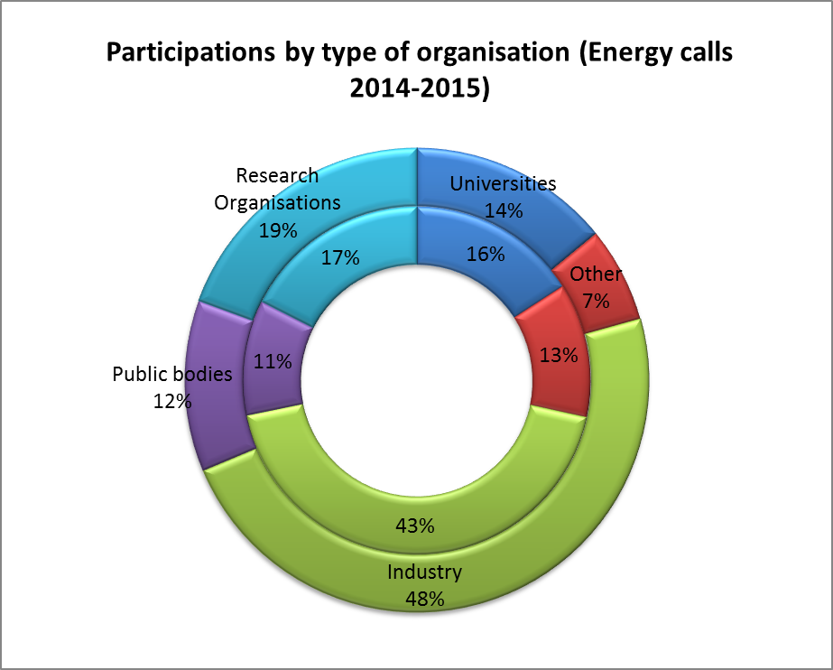
Horizon 2020
Challenge Energy
So far
Number of participations
EU contribution

Slide 13
Towards a European Energy Union (February 2015)
EU Energy Policy
Energy Union
Five pillars:
Energy supply security, solidarity and trust;
A fully integrated European energy market;
Energy efficiency contributing to moderation of demand;
Decarbonising the economy
Promoting Research, Innovation and Competitiveness → Priorities

Slide 14
Research, Innovation and Competitiveness - Priorities
EU Energy Policy
Energy Union
World leader in developing the next generation of renewable energy technologies,
Participation of consumers
Efficient energy systems,
Energy systems integration
A forward-looking approach to carbon capture and storage (CCS) and carbon capture and use (CCU)
Nuclear energy

Slide 15
Policy Initiatives in progress
EU Energy Policy
Energy Union
More than 40 policies to be revised or initiated by 2017
Research and Innovation Strategy:
Toward an Integrated Strategy Energy Technology Plan (Published in September 2015)
A strategic transport research and innovation agenda (2016)
A strategic research, innovation and competitiveness roadmap (2016)

Slide 16
EU Energy Policy
SET - Plan
Where we are coming from
The Strategy Energy Technology -Plan, adopted in November 2007, is the technology pillar of the EU's energy and climate change policy
Objective is to accelerate the development of low carbon technologies leading to their market take-up
EUR 8 billion/year over next 10 years
Vision:
Achieve 2020 objectives at a lower cost by accelerating the development of necessary technologies
Strong competitiveness of EU industry in a portfolio of clean, efficient and low carbon technologies – as a motor for growth and jobs

Slide 17
European Industrial Initiatives
EU Energy Policy
Research Approach
SET - Plan
Where we are coming from
Public-private partnerships by technology sector gathering EU, Member States & industry
Develop & execute industry-led implementation plans – monitored by Steering Group
8 Industrial Initiatives so far:
European Wind Initiative (June 2010)
Solar Europe Initiative (June 2010)
Bio-energy Europe Initiative (November 2010)
European Electricity Grid Initiative (Smart Grids) (June 2010)
European CO2 capture, transport and storage initiative (June 2010)
Nuclear: Sustainable fission initiative (Gen IV) (November 2010)
Fuel cells & hydrogen (specific structure: Joint Technology Initiative) (May 2008)
Smart Cities (combination of technologies applied to urban areas)

Slide 18
European Energy Research Alliance
EU Energy Policy
Research Approach
SET - Plan
Where we are coming from
Coordinates capacities & efforts of major EU labs & research centres
Independent association open to all EU research organizations with significant R&D capacity and interested in “joint programming”

Slide 19
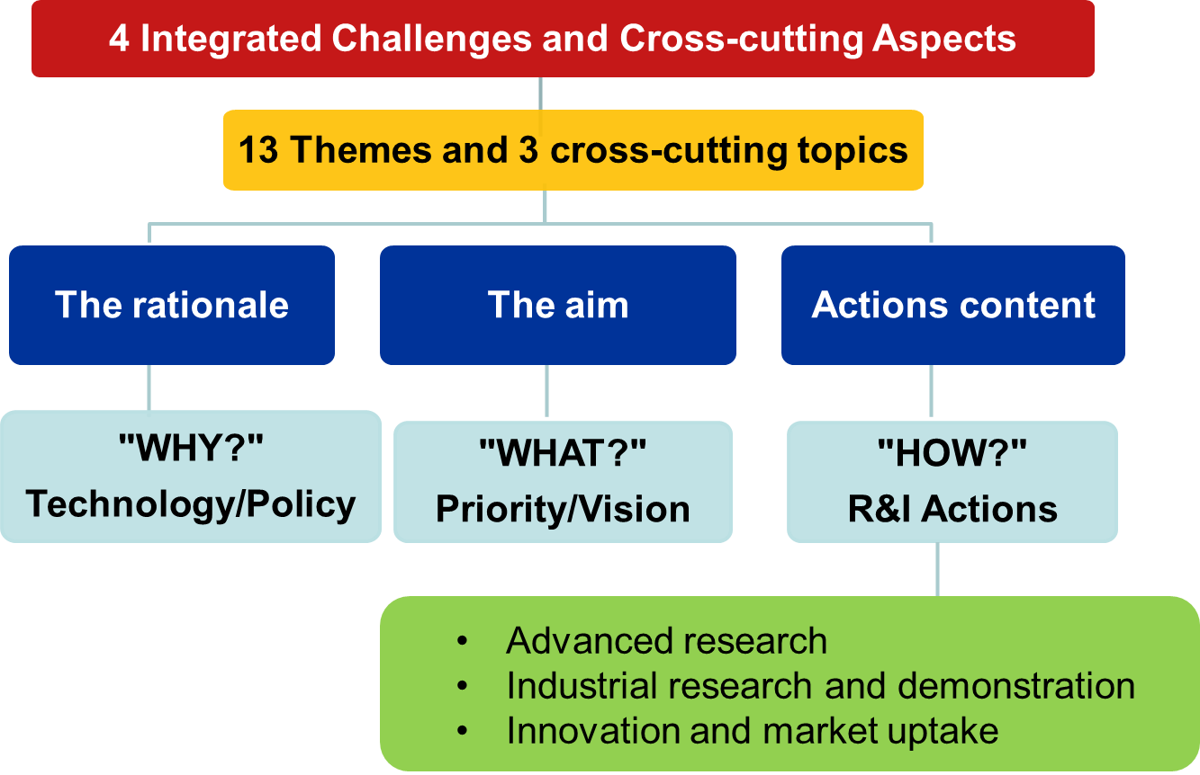
Toward an Integrated Strategy Energy Technology Roadmap (November 2014)
EU Energy Policy
Research Approach
SET - Plan
Where we are coming from

Slide 20
Toward an Integrated Strategy Energy Technology Plan (September 2015)
EU Energy Policy
Research Approach
SET - Plan
What we are doing
A more targeted focus (10 actions)
A more integrated approach
New Governance
Increased Accountability

Slide 21
A more targeted focus – 10 actions
EU Energy Policy
Research Approach
SET - Plan
What we are doing
1 Sustain technological leadership by developing highly performant renewable technologies and their integration in the EU’s energy system
2 Reduce the cost of key technologies
3 Create technologies and services for smart homes that provide smart solutions to energy consumers
4 Increase the resilience, security and smartness of the energy system
5 Develop new materials and technologies for, and the market uptake of, energy efficiency solutions for buildings

Slide 22
A more targeted focus – 10 actions
EU Energy Policy
Research Approach
SET - Plan
What we are doing
6 Continue the efforts to make EU industry less energy intensive and more competitive
7 Become competitive in the global battery sector to drive e-mobility forward
8 Strengthen market take-up of renewable fuels needed for sustainable transport solutions
9 Step up R&I activities on the application of carbon capture and storage (CCS) and the commercial viability of carbon capture and use (CCU)
10 Maintaining a high level of safety of nuclear reactors and associated fuel cycles during operation and decommissioning, while improving their efficiency

Slide 23
EU Energy Policy
Research Approach
SET - Plan
What we are doing
Integrated Roadmap Energy Union SET-Plan Objectives
Themes* 4+2 R&I priorities Ten Actions Measure progress
T10: Wind, PV, CSP, SHC
T12: Nuclear
T11: CCS
T6: Smart grids
T5: En. eff. industry
T13: Biofuels, FCH
Efficiency
RES
Transport
Smart
CC(U)S
Nuclear
1. Develop RES
2. Reduce cost
3. Smart home
4. Smart System
5. Building
6. Industry
7. Battery
8. RES-fuels
9. R&I on CC(U)S
10. Safety Nuclear
OWE: 30% by 2030…
T9: Smart cities
T3: En. eff. buildings
T4: En. eff. H/C
T2: Activating consumers
T1: Engaging consumers
T7: Energy storage
T8: System flexibility

Slide 24
EU Energy Policy
Research Approach
SET - Plan
What we are doing
To develop and deliver on the 10 actions
Commitment of the Member States and Associated Countries
Stakeholders
For each 10 priorities to define:
The level of ambition in terms of priorities and funding;
The modalities of the implementation
Expected deliverables and timing for achieving results

Slide 25
General Principles
EU Energy Policy
Research Approach
Work Programme
Approach
EU Policies
Energy, Transport, Climate Change, Growth, etc…
Stakeholder
SET Strategic Roadmaps
SET Plan commitments
ETP SRAs
Others..
Long term vision
To start now the R&D of the technology needed in the market in 40 years time

Slide 26
Impacts of COP21 outcomes
On The Horizon
Policy development
Three important outcomes
Calls for increased support for 'collaborative approaches to research and development, and for facilitating access to technology’,
Mission Innovation: 20 major world economies (including UK, FR, DE, IT, DK, SE, NO) who committed to doubling their government and/or state-directed clean energy R&D investment over five years to 2020,
Private sector investment via the Breakthrough Energy Coalition,

Slide 27
Time schedule
On The Horizon
H2020
Mid-Term Review
Evidence gathering: up to September 2016
Public Consultation: October – December 2016
Results: September 2017
➔ Your contributions are welcome

Slide 28
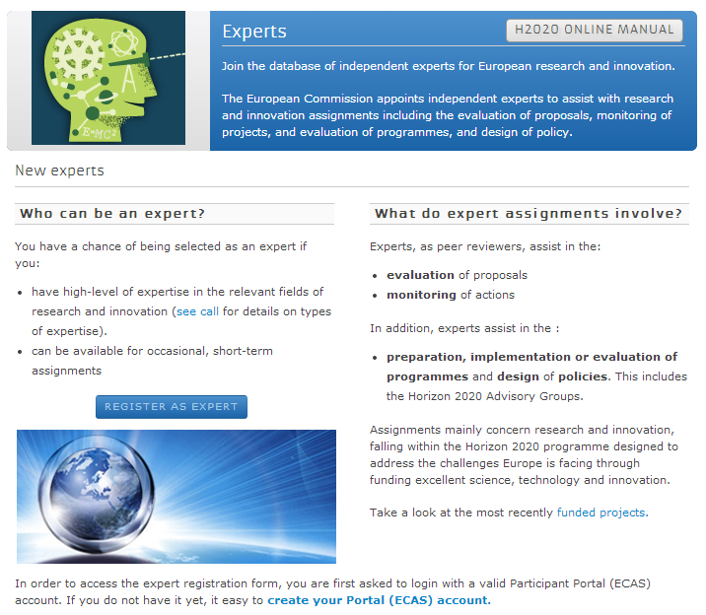
Sign up as an expert
H2020 Participant Portal:
ec.europa.eu/research/participants/portal
Notes:
External evaluators of project proposals are drawn from the European Commission's independent expert database.
The Commission is looking to expand the database through a call for experts covering a very broad range of fields.
If you fit the expert profile rather than that of an applicant, and would like to be considered as a proposal evaluator, sign up in the Participant Portal.
Select ‘Experts’ tab on the main portal’s menu

Slide 29
Some issues about Mid-Term Review for us
1. The whole process is already set out in quite some details by the commission.
2. H2020 has already set up a group of experts (AGE)
with well defined mandate for 2016-2017
3.The commission has also appointed other groups of experts.
4.The commission has pointed out the Horizon2020 indicators for the assessment
5. Several statements from groups exist to show their interest (Euroscience-ISE). Should EPS produce its own document or join other initiatives ?

Slide 30
2018-2020
On The Horizon
H2020
Work-Programme
Strong contribution already from SET-Plan activities
➔ More focus on short to medium terms issues
The technologies of tomorrow
➔ We are looking for the next technology possible breakthroughs

Slide 31
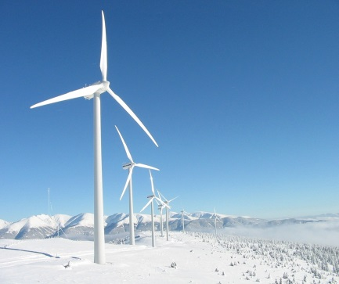
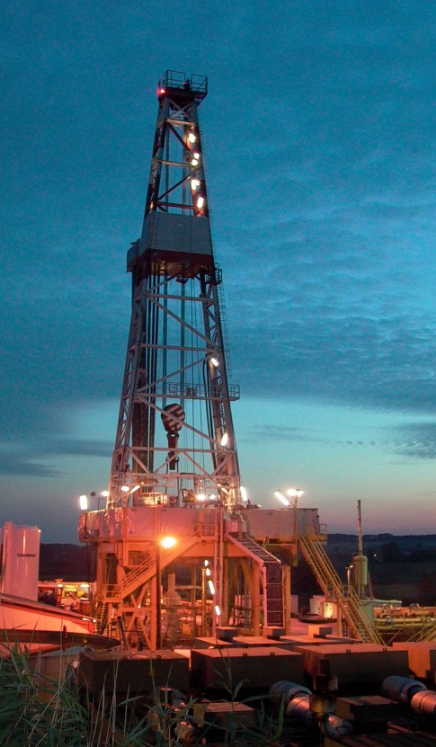
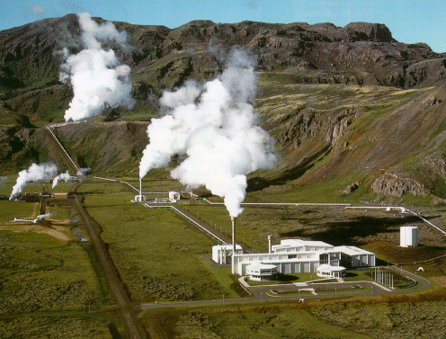
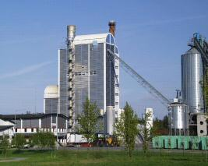
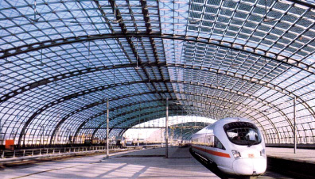
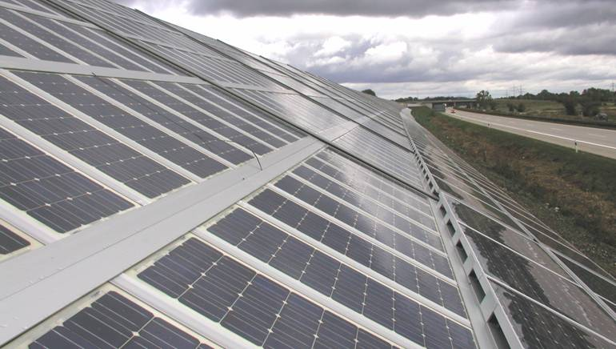
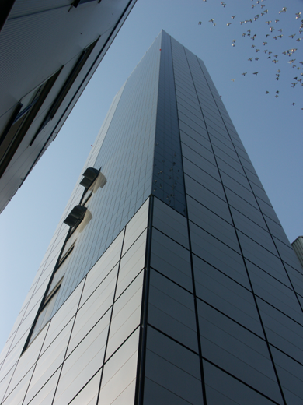
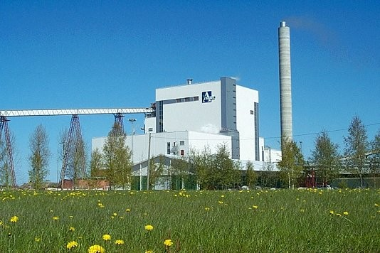
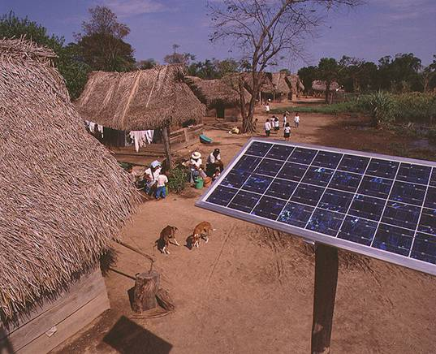

Slide 32
Thank you
More information:
www.ec.europa/research/horizon2020

